Slide 1

Easy Finance – Process Definitions
Digitalization China
August 2018

Slide 2
EF-EP-006
EPIC:
Binding Offer Management (DFE Review and Audit)

Slide 3
EF-EP-006: Binding Offer Management (DFE Review and Audit)
Story ID: EP 006-S 001:
Moved to EP 005-S 005.
Story ID: EP006-S 002:
As a user, I want to get confirmation of my quotation by F&I, and the quotation information couldn’t be changed by myself after quotation submitted, so that I'm able to proceed with the loan application.
Story ID: EP006-S 003:
As a user of DFE, I want to review & audit the quotation which is selected by the applicants, if all information is correct, click "confirmed", then follow existing process. if it’s incorrect, I will help to change to correct.
Story ID: EP006-S 004:
As a user, I want to be notified the quotation information which has been confirmed by F&I, following the comment which F&I left, so that I'm able to proceed to E-authentication.
Story ID: EP006-S 005:
As a user, I want to be notified if the offer is expired, so that I cannot apply for an expired SF product offer.

Slide 4
Story ID: EP006-S002-Alex Wang:
Business
As a user, I want to get confirmation of my quotation by F&I, so that I'm able to proceed with the loan application. The quotation information couldn’t be changed by myself after quotation submitted.
Assumptions:
ASSUMPTION A
ASSUMPTION B
ASSUMPTION C
Pre-Conditions:
Customer selected right dealership’s name.
Acceptance Criteria:
The E-quotation will be send to DFE, and under the F&I’s account with same dealership’s name which customer selected.
The App will auto-check mandatory information of quotation before applicant click ‘submit quotation’ button.
If missing some mandatory information, applicants need to go back quotation page to fill that part out.
Show successful submission page after applicant submit quotation confirmation completely.
Once E-quotation submitted, user couldn’t change quotation information by themselves anymore.
Update application status as ‘waiting F&I to confirm’ in eAPP.
A disclaimer should be display below to remind user please be careful about financial product’s validation time.
IT
Legal
Compliance

Slide 5
Story ID: EP006-S002-Alex Wang:
Mock up:
For missing mandatory information
For all information is completed
back
Quotation overview
Your quotation is submitted successfully.
Please wait a moment for your F&I to confirm…
Model
Please go back to quotation page to fill the XXX, then submit again.
Transaction Price
Financial product
OK
。。。
Monthly installment
Submit Quotation to confirm

Slide 6
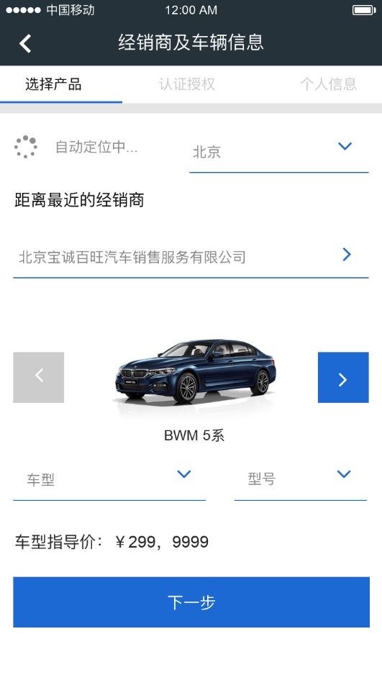
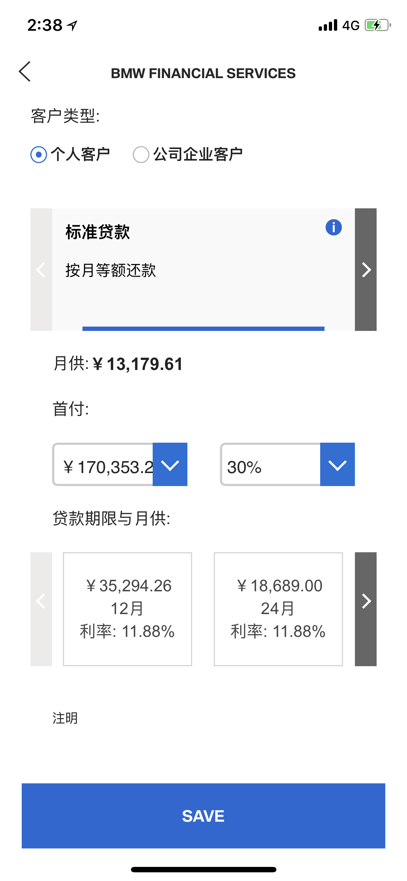
Story ID: EP006-S002-Alex Wang:
Wireframes:
For missing mandatory information
back
Quotation overview
Your quotation is submitted successfully.
Please wait a moment for your F&I to confirm…
Model
Please go back to quotation page to fill the XXX, then submit again.
Transaction Price
Financial product
OK
。。。
$ 250, 000
Monthly installment
Submit Quotation to confirm
back
back
Quotation overview
Quotation overview
Vehicle Status:
New
Brand:
BMW
Payment schedule
Year:
2018
Series:
5 Ser
Model:
530li
Packages:
Sports
Usage Type:
Private
Mortgage Type:
Mortgage/ Free
Product:
Retail loan
Sub-Product
Balloon
Purchase Price:
300,000.00
Terms:
36
ASP Price:
10,000.00
Vehicle Down payment:
30
%
90,000.00
Submit Quotation to confirm
Total Down payment:
92,000.00
Vehicle Financial Amt:
70
%
270,000.00
Total Financial Amt:
278,000.00
Installment:
5,000.00
Balloon Value:
20
%
60,000.00
Some information is mandatory in DFE quotation, but customer don’t need to select, because these information can be auto-filled according to other info.
Vehicle Code: Brand + Series + Model + Package
Payment type (bullet/balloon): Sub-product
Payment frequency (monthly): Sub-product
Entity (AFC/HIL): Product

Slide 7
Story ID: EP006-S001 & ES-S002-Alex Wang:
Process Flow:
APP
Remind financial product will be expired in X days
Easy Finance APP
Quotation confirmation
Process
DFE
Quotation confirmation
Process
If financial product will be expired in X days
APP
Check all mandatory information is filled
User
Submit quotation
F&I
Review quotation
If financial product will be not expired in X days
If financial product is expired.
APP
Change another valid financial product

Slide 8
Story ID: EP006-S003-Alex Wang:
Business
As a user of DFE, I want to review & audit the quotation which is selected by the applicants, if all information is correct, click "confirmed", then follow existing process. if it’s incorrect, I will help to change to correct.
Assumptions:
ASSUMPTION A
ASSUMPTION B
ASSUMPTION C
Pre-Conditions:
eAPP integrated with DFE for quotation confirmation.
Acceptance Criteria:
The E-quotation will under the F&I’s queue in DFE, depend on dealer name which applicants selected in eAPP.
As same as present quotation layout in DFE, all quotation information is displayed on DFE quotation tab.
Add 3 new button: ‘Confirm’, ‘Modify’, ‘Close’
Confirm: Trigger this application go to next step – E-authentication in eAPP, at same time, create a application in DFE.
Modify: is able to change quotation information in DFE.
Close: Just close and exit this quotation page with doing nothing.
4. F&I is able to modify the quotation in DFE. (Follow existing DFE rules)
IT

Slide 9
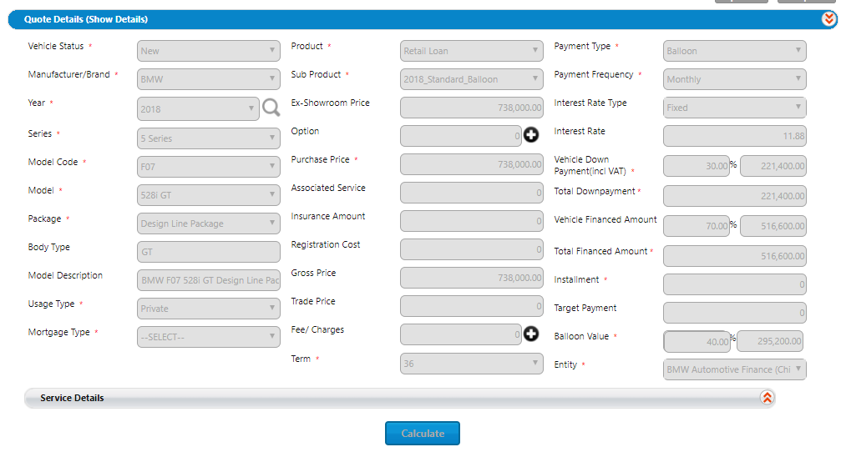

Story ID: EP006-S003-Alex Wang:
Mockups:
Confirm
Modify
Close

Slide 10
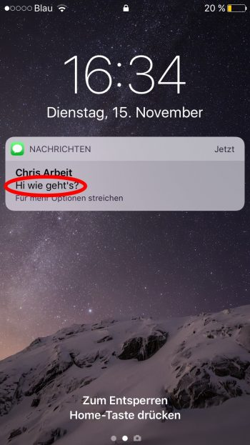
Story ID: EP006-S003-Alex Wang:
Wireframes:
Your quotation is submitted successfully.
Please wait a moment for your F&I to confirm…
Customer view
Quotation is confirmed
Push Notification to the customer
F&I view
Confirm
Modify
Close

Slide 11
Story ID: EP006-S004-Alex Wang:
Business
As a user, I want to be notify and review the quotation information which has been confirmed by F&I, following the comment which F&I left, so that I'm able to proceed to E-authentication.
Assumptions:
ASSUMPTION A
ASSUMPTION B
ASSUMPTION C
Pre-Conditions:
eAPP integrated with DFE for quotation confirmation.
Acceptance Criteria:
Display the quotation summary which F&I confirmed in DFE.
I couldn’t change any quotation information after I submit E-quotation in first time.
If I saw some wrong quotation information, I need to ask F&I change it in DFE only.
If all quotation is correct, I will go to next step for E-authentication.
Push notification to the customer user to notify that the quotation is confirmed by the F&I
IT

Slide 12
Story ID: EP006-S004-Alex Wang:
Mockups:
Quotation is confirmed

Slide 13
Story ID: EP006-S003-Alex Wang:
Wireframes:
Your quotation is submitted successfully.
Please wait a moment for your F&I to confirm…
Customer view
Quotation is confirmed
Push Notification to the customer
F&I view
Confirm
Modify
Close

Slide 14
Story ID: EP006-S003 & S004-Alex Wang:
Easy Finance APP
E-Authetication
Process Flow:
DFE
Quotation confirmation
Process
F&I
Pass quotation without incorrect info
User
Review quotation summary and
Go to E- authentication
F&I
Review quotation
F&I
Modify quotation

Slide 15
Story ID: EP006-S005-Alex Wang:
Business
IT
As a user, I want to be notified if the offer is expired, so that I cannot apply for an expired SF product offer.
Assumptions:
XXX
Pre-Conditions:
The expiration rules of financial product has been configured in eAPP or one calculator.
All quotation information which DFE is needed (incl. transaction price) is selected by applicants in eAPP.
Acceptance Criteria:
The App will auto-check expired date of selected financial product before applicant click ‘submit quotation’ button.
If the submission date is within X days from expired date of selected financial product, a pop-up will remind applicant that “Please submit your loan application in X days.”

Slide 16
Story ID: EP006-S005-Alex Wang:
Mockups:
Pop up window once the customer is entering the APP and the Financial offer is expired
Sorry, the financial product is expired right now, please change it.
OK

Slide 17
Story ID: EP006-S005-Alex Wang:
Customer left the app for X amount of days and re-enters
Please submit your loan application in X days
Sorry, the financial product is expired right now, please change it.
OK
OK
$ 250, 000
$ 250, 000

